Slide 1


Major Project Defense
INTERNET BASED SERVICES OVER SMS AND VOICE CALL FOR GSM FEATURE PHONES.
Presented by-
Nishant Nischaya - 03314802816 Nikhil Prakash - 03214802816
Pratham Chhabra - 03614802816
Under the guidance of-
Ms. Abhilasha Gokhale

Slide 2
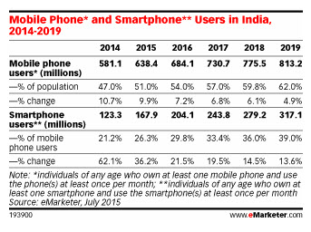
Some Statistics
According to 2018 Newzoo's Global Mobile Market Report, India Ranks 40th in Smartphone penetration in a list of 50 nations with only 27.7% percentage of population owning a smartphone.
Demography consisting feature phone users is -
Families of SEC-2 and SEC-3 category
Urban Poor
Students of Teir-2 and Teir-3 cities
Agriculture Sector

Slide 3
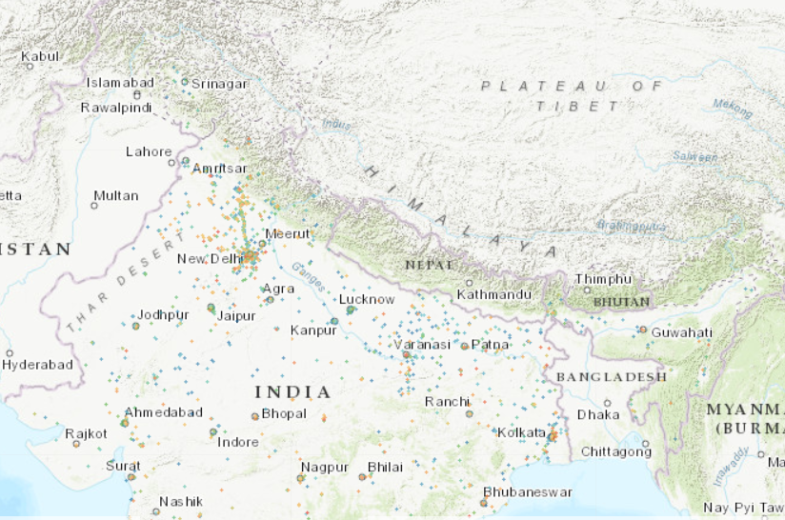
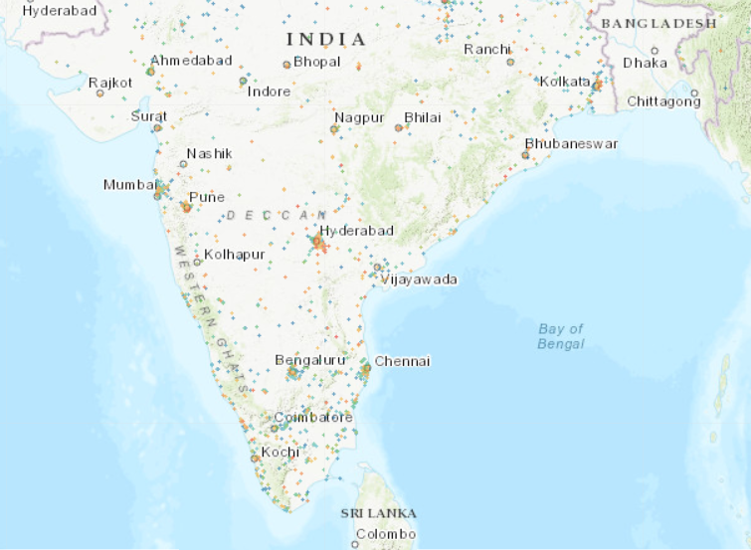
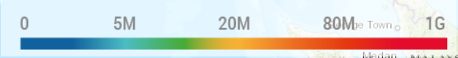
Some Statistics
In December 2019, India's rank was declared as 128th in a list of 140 countries in mobile data download speed by Ookla.
Average speed recorded was 11.46 Mbps whereas the global average was 32.01 Mbps.
Map Source-
https://www.nperf.com/en/map/IN//1639.Airtel/download/?ll=15.572244602734123&lg=82.08105415105821&zoom=5

Slide 4
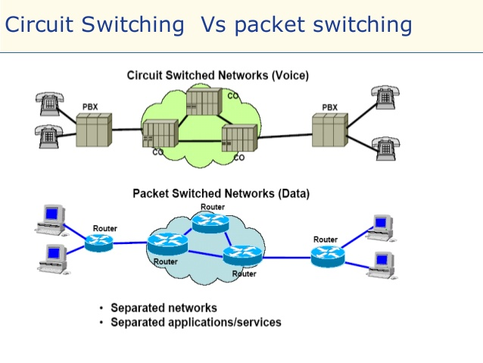
GSM vs GPRS (How Mobile Internet works?)
GSM : refers to Global System for Mobile Communication. It is a digital circuit switched networking technology for full duplex voice telephony and SMS (Short Message Service).
GPRS : It is packet data transport network for internet applications. Hence referred as General Packet Radio Service. It is based on packet switched networks.

Slide 5
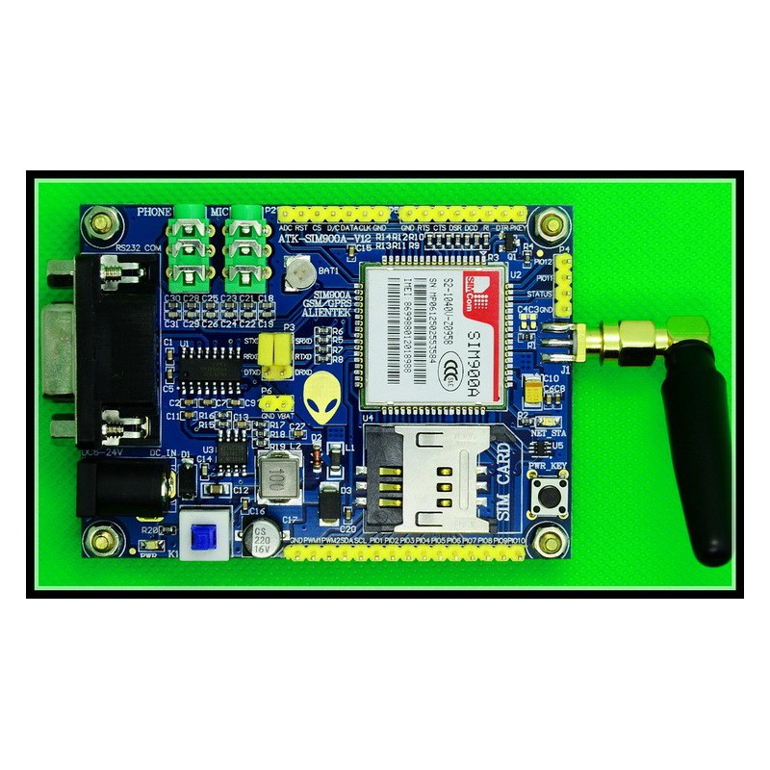
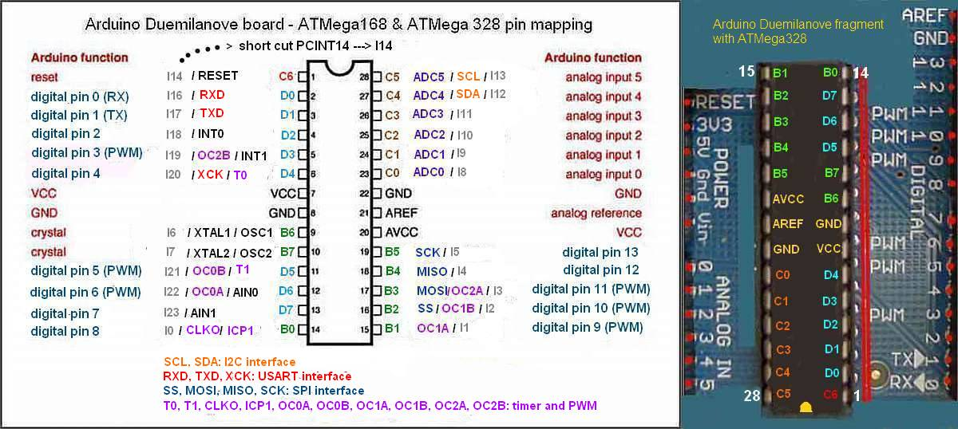
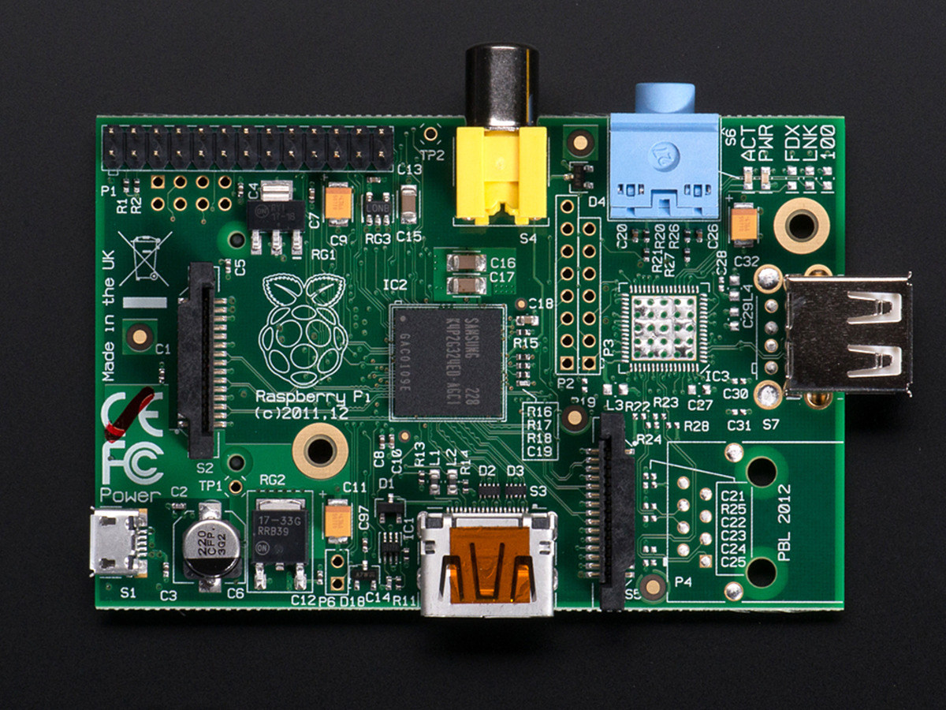
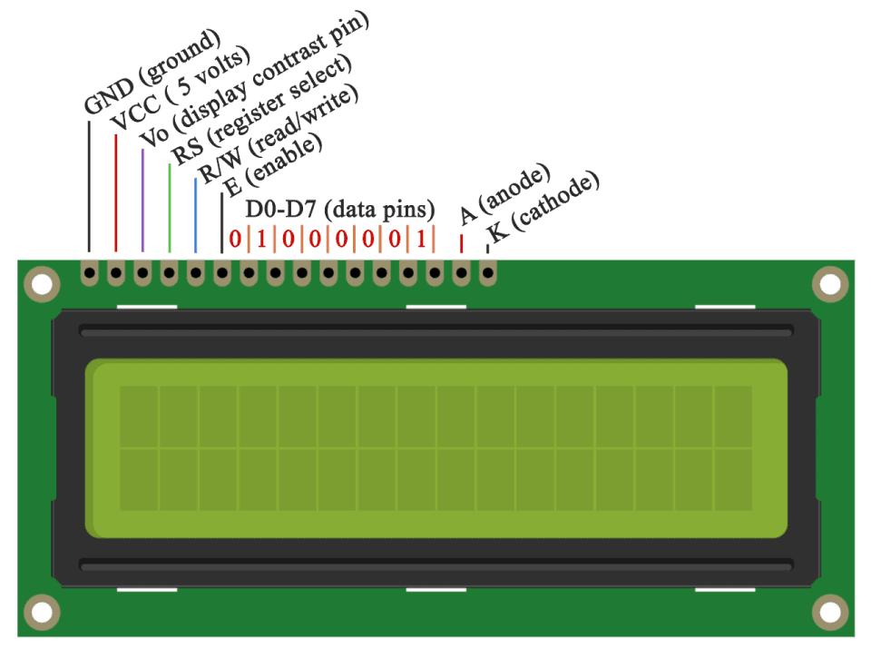
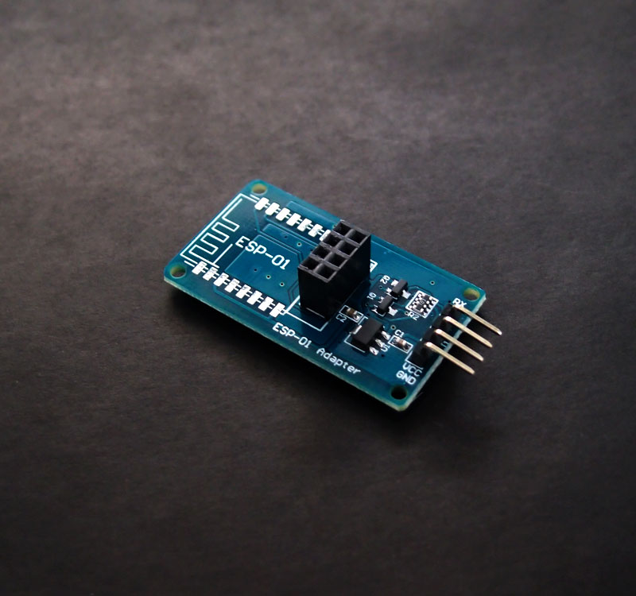
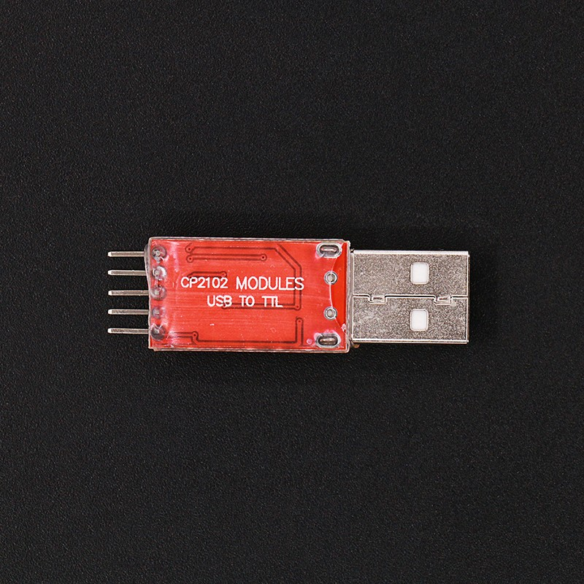
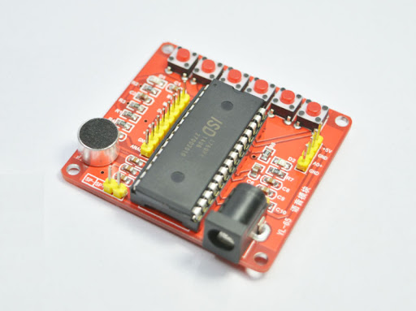
Components Required
SIM900A
Module
ATMEGA328P
Raspberry Pi 3
LCD SCREEN16X2
USB to TTL coverter
Voice Recorder
Module
ESP8266 WiFi
Module

Slide 6
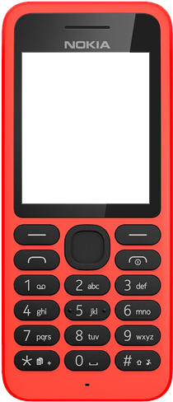




SMS
Go Chlorophyll
Project Working
SEND
Step 1: Making a query (Write SMS)
Go <Type your search query>
Tweet <Type your tweet>
News
Go
Chlorophyll

Slide 7
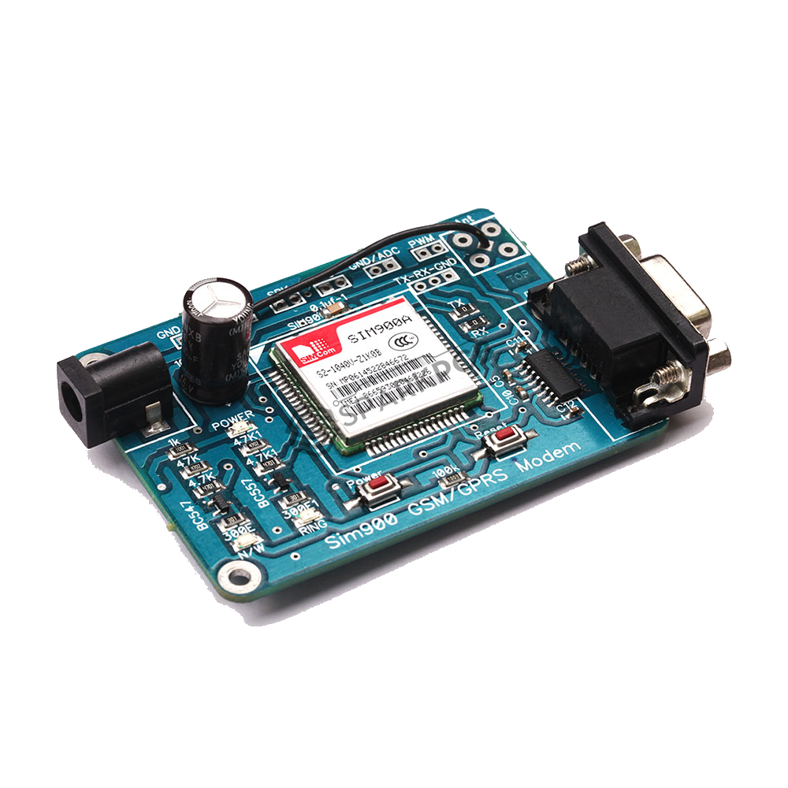
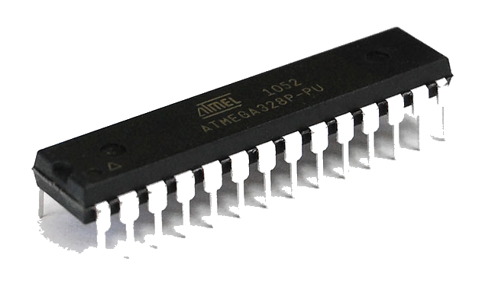
Go
Chlorophyll
Step 2: Sending and Receiving of SMS
AT COMMANDS
Setting SIM900A in SMS mode: AT+CMGF=1
Ready for sending: AT + CMGS = "+91 PHONE” MESSAGE
Terminating message: CTRL+Z
Ready for Receiving SMS: AT+CNMI=2,2,0,0,0
Go Chlorophyll

Slide 8
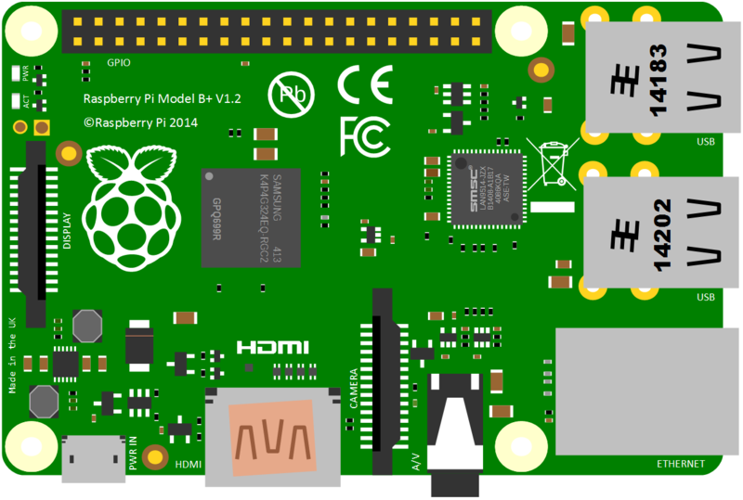






Go Chlorophyll
Raspberry Pi: Query Reception and APIs
Request
Chrolophyll
Internet
API
Search
News
Response
Sports
Twitter
Voice assistance
Weather

Slide 9
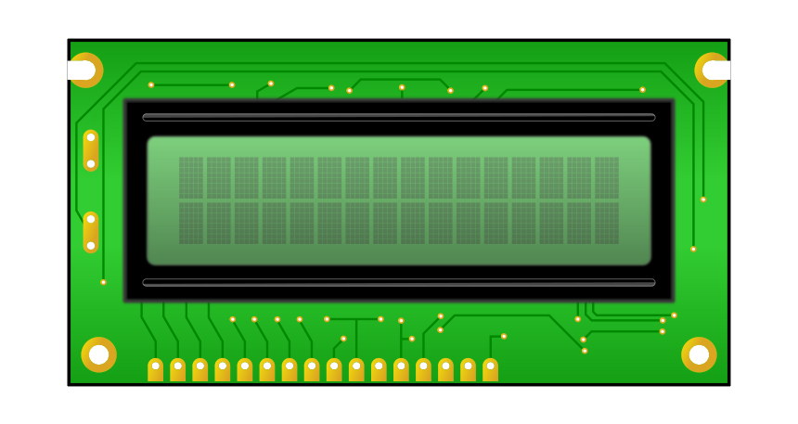
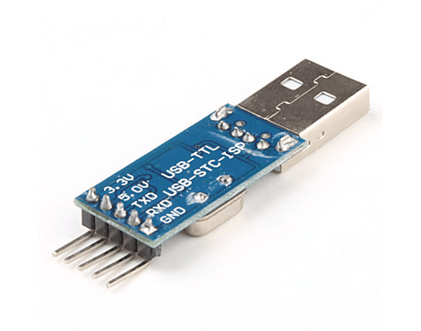
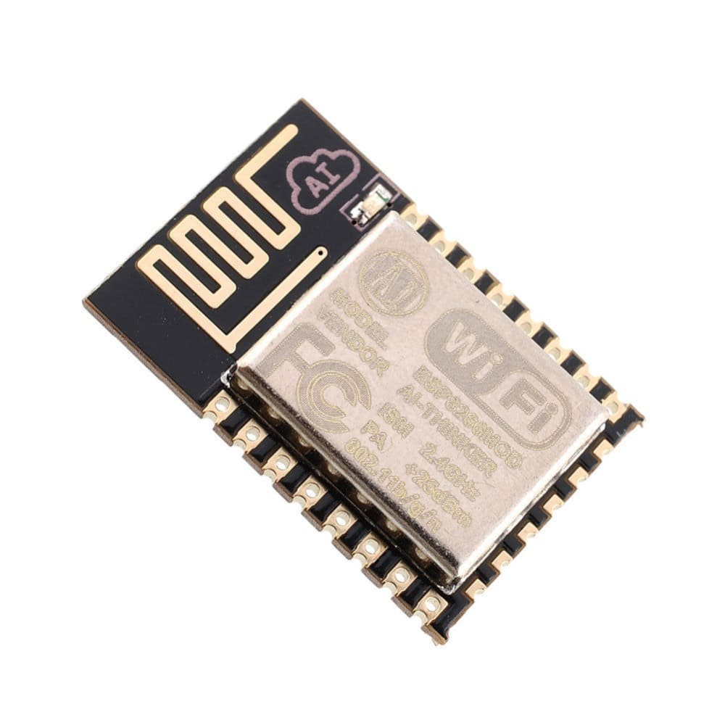
PROJECT WORKFLOW
16X2 LCD
Shows current status of Queue.
Shows incoming requests.
Client Device
ATMEGA 328P
Sends and Receives SMS data.
Sends AT commands to SIM900A.
Segregates the query on the basis of query type.
SIM900A
Mode is set using AT Commands.
Sends and receives SMS at Server-side.
Give Audio in/out ports for
voice calls.
Raspberry Pi 3b+
Runs API.
Runs Voice Assistant
OR

Slide 10
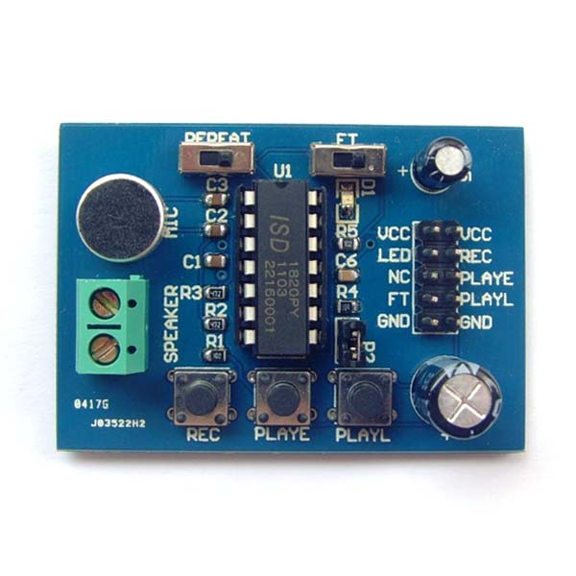
01
Voice Assistant
02
Markdown webpage*
ADDITIONAL
FEATURES
03
Request Queue
04
Image Transfer*
* The feature would depend on capability of mobile phone handset.

Slide 11
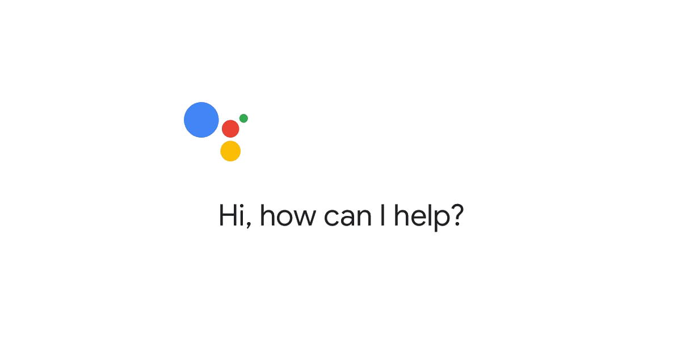

Voice Assistant Integration
Voice Assistant

Slide 12
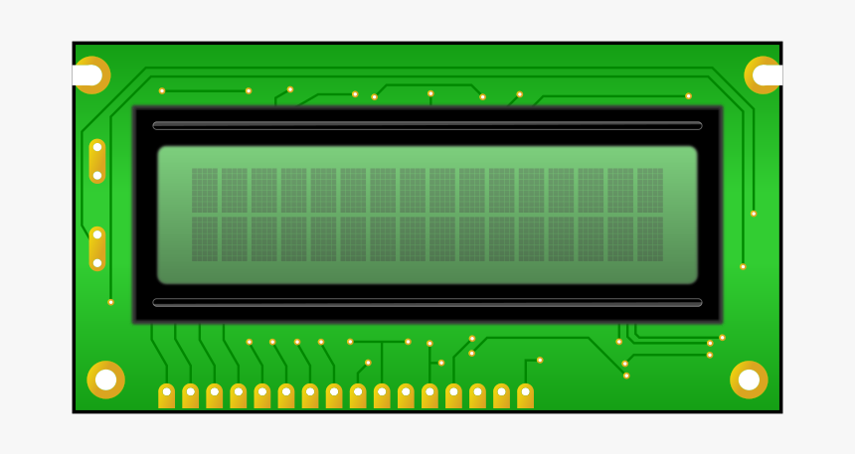
Queing of Requests
1
Go Coronavirus
QUEUE STATUS - 2
“NEWS” +91-98115679711
2
News
3
Weather Delhi
STATUS WILL BE DISPLAYED ON 16 X 2 LCD SCREEN
4
HOLD
Voice Request

Slide 13
THANK YOU!

